Slide 1
An improvement of Decoupled L1D
杨伟光
2016-04-19

Slide 2
Menu
Decoupled L1D review
GPU cache inefficiency
Cache review
Decoupled L1D Operation & SM dueling
Drawback of Decoupled L1D
Application categorization
SM dueling
Experiment

Slide 3
Decoupled L1D review
Massively parallel, throughput-oriented
Cache contention / Cache pollution / Cache inefficiency
Bypass(Decoupled L1D )
Decoupled L1D : only the data with high reuse and short reuse
distances are stored in the L1 D-cache
Li, C., Song, S. L., Dai, H., Sidelnik, A., Hari, S. K. S., & Zhou, H. (2015). Locality-Driven Dynamic GPU Cache Bypassing. Proceedings of the 29th ACM on International Conference on Supercomputing - ICS ’15 (Vol. 1, pp. 67-77).

Slide 4
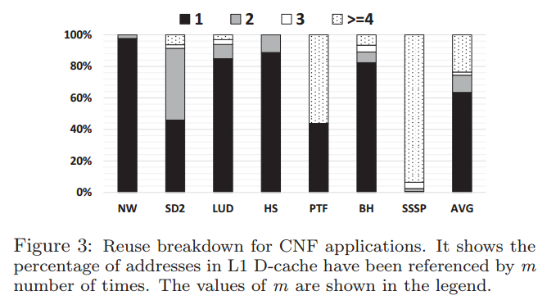
GPU cache inefficiency
memory requests for the majority of CNF applications are only reused less than three times.

Slide 5
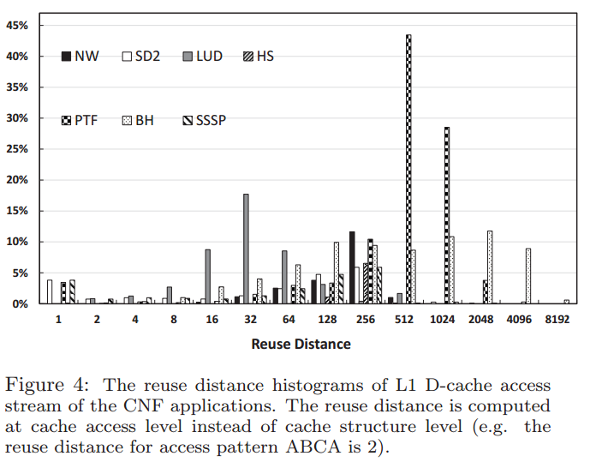
GPU cache inefficiency
the reuse distances are relatively high

Slide 6
Cache review
tag
index
byte in block
2b
3 bits
3 bits
Tag store
Data store
Address
V
tag
=?
MUX
byte in block
Hit?
Data
6

Slide 7
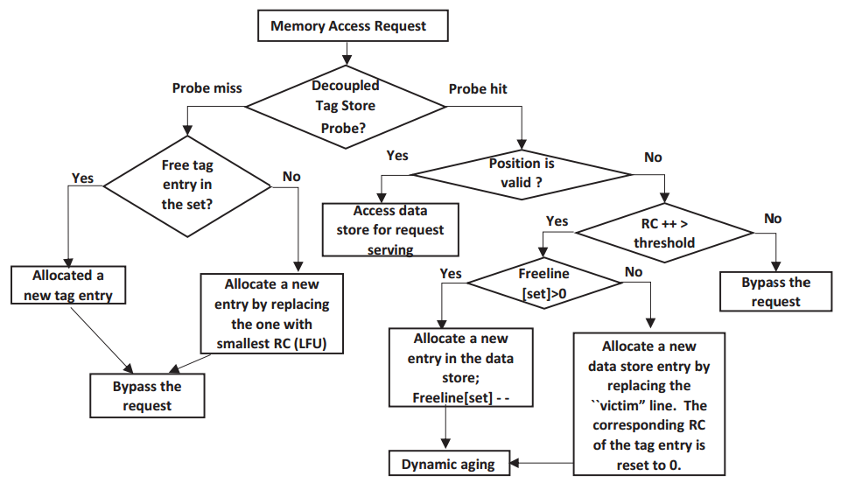
Decoupled L1D
Decoupled L1D : Operation

Slide 8
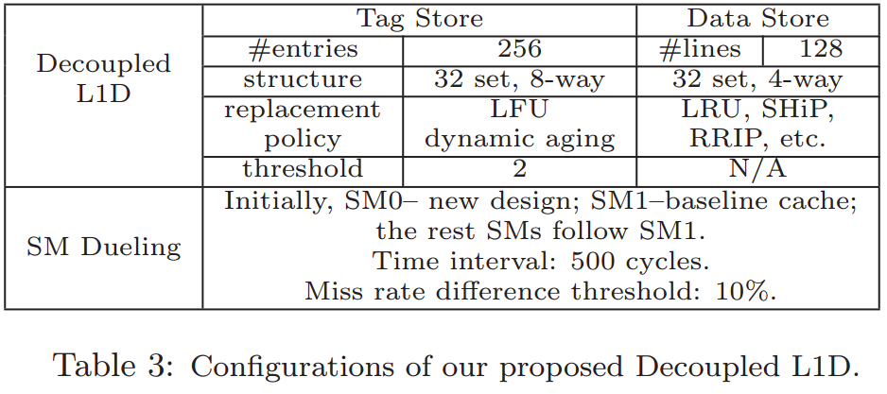
Decoupled L1D
Decoupled L1D : SM Dueling

Slide 9
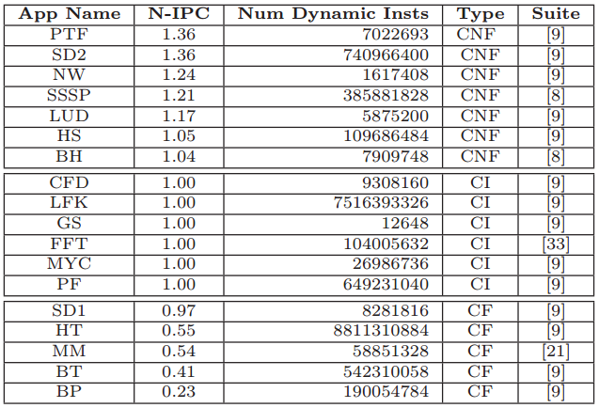
Drawback of Decoupled L1D
Application categorization
Taken the Bypass Path
VS
all taking the L1 D-Path
Applications whose IPC improvement is greater
than 1 are classified as Cache Unfriendly (CNF)
Applications whose IPC values are not impacted
are classified as Cache Insensitive (CI)
IPC improvement is less than 1 are
Cache Friendly (CF):

Slide 10
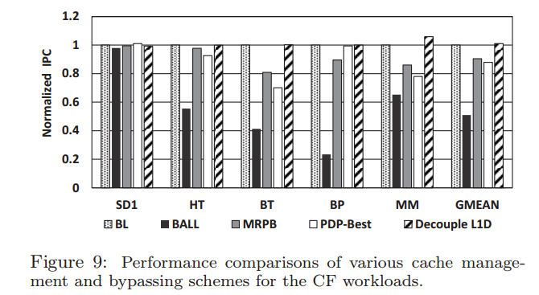
Drawback of Decoupled L1D
SM dueling
IPC improvement is less than 1 are
Cache Friendly (CF)
The impact of Decoupled L1D to
Cache Friendly (CF)

Slide 11
Impact of Decoupled L1D to Cache Friendly benchmark (CF)
motivation：decoupled L1D算法会造成CF性能降低。
解决方式：动态RC的decoupled L1D算法。
预期效果：对CNF的IPC更大，对CF的的性能降低减少，甚至达到性能提高。
但是SM dueling策略在这里不能很好的解决Decoupled L1D算法会对造成CF性能降低问题。
理论上，（1）选取SM0始终执行decoupled L1D算法，对于CF，会造成至少1/SM_num的性能降低。（2）SM0已经bypass掉了一些L1 访存请求，那么对于SM0，missrate就不能很好的反映运行状态，采用对比SM0和SM1 missrate作为仲裁点是不合理的。为了证明猜想，我做了以下探究实验：

Slide 12
Experiment 1
不同benchmark输入不同数据量（使benchmark的运行指令数分别在1亿左右，5亿左右），观察IPC

Slide 13
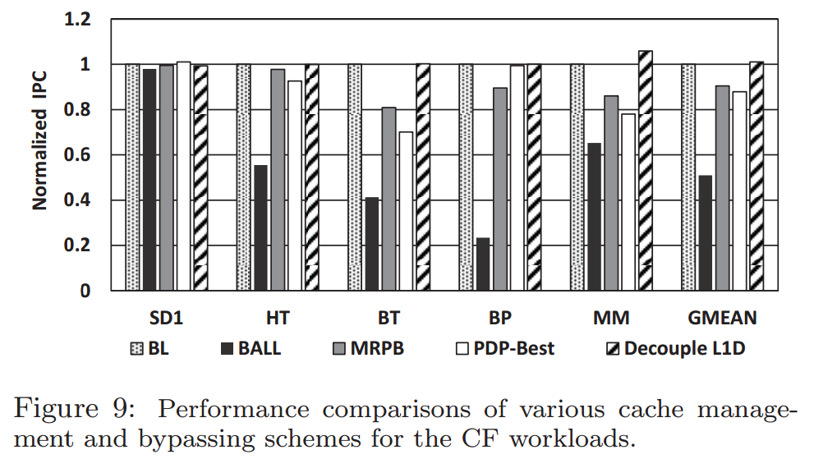
Experiment 2
对于CF和CI，说明鲁棒性更好

Slide 14
Thanks

